Slide 1

KNIME ANALYSIS PLATFORM
YASH MEHTA(16CE049)
JAINIL PATEL(16CE068)

Slide 2
What is Knime Tool?
KNIME Analytics Platform is the open source software for creating data science applications and services.
Intuitive, open, and continuously integrating new developments, KNIME makes understanding data and designing data science workflows and reusable components accessible to everyone.

Slide 3
Features
Core KNIME features include:
Highly and easily extensible via a well-defined API for plugin extensions
Intuitive user interface
Import/export of workflows (for exchanging with other KNIME users)
Parallel execution on multi-core systems

Slide 4
Build data science workflows
Create visual workflows with an intuitive, drag and drop style graphical interface, without the need for coding.
Blend tools from different domains with KNIME native nodes in a single workflow, including scripting in R & Python.
Choose from over 2000 modules ("nodes") to build your workflow. Model each step of your analysis, control the flow of data, and ensure your work is always current.
Get up and running quickly. Select one of the hundreds of publicly available example workflows, or use the integrated workflow coach to guide you through building your workflow.

Slide 5
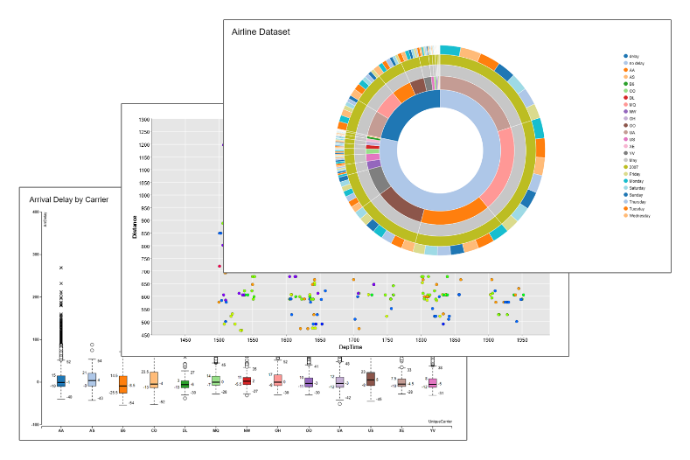
Discover and share insights
Visualize data with classic (bar chart, scatter plot) as well as advanced charts (parallel coordinates, sunburst, network graph, heat map) and customize them to your needs.
Display summary statistics about columns in a KNIME table and filter out anything that’s irrelevant.
Export reports as PDF, PowerPoint, or other formats for presenting results to stakeholders.
Store processed data or analytics results in many common file formats or databases.

Slide 6

Knime as a solution
Better than others because:
Uses simple and intuitive GUI
Easy node configuration and execution
Based on Eclipse platform
Many relevant examples
Useful help – node description
Good for begginers
Notes:
Better than others because :
Uses simple and intuitive GUI- can be used by any scientist , regardless on his IT technologies knowledge
Easy node configuration, and clear execution
Based on Eclipse platform
Many relevant examples
Useful help – node description
Good for begginers as well as experienced users
. KNIME has been developed from day one using rigorous professional software engineering processes since it was clear from the beginning that it was to be used in large scale enterprises.
The initial goal was to create a modular, highly scalable and open data processing platform which allowed for the easy integration of different data loading, processing, transformation, analysis and visual exploration modules without the focus on any particular application area. The platform was intended to be a collaboration and research platform and should also serve as an integration platform for various other data analysis projects out there.
In 2006 several pharmaceutical companies started using KNIME and a number of life science software vendors began integrating their tools into KNIME. Later that year, after an article in the German magazine c't^{[1]}, users from a number of other areas joined ship. As of summer 2009, KNIME is in use by over 2.000 actual users (i.e. not counting downloads but users regularly retrieving updates when they become available) not only in the life sciences but also at banks, publishers, consulting firms, and various other industries but also at a large number of research groups world wide.

Slide 7
Conclusion
Data mining is not an automated process
Data mining needs appropriate SW tools
Frequently more than one SW
Knime is an effective solution for educational purposes
Lot of space for improvements in:
Supporting various data sources
Providing high performance data mining
Providing more domain-specific techniques
Better support for business application
Notes:
Data mining is not automated process, no matter how effective DM software is
We present the four following important points for open source data mining
systems to gain greater success in deployment:
1. Supporting various data sources
A good open source data mining system should support most commonly
used data sources, such as the open source and commercial databases, csv
files, and user defined formats.
2. Providing high performance data mining
Most open source data mining systems can’t operate on large volumes of
data. To offer high performance data mining we need to either rewrite the
algorithms (e.g. parallel and distributed algorithms) or more simply to improve
the hardware on which the software is running.
3. Proving more domain-specific techniques
Most data mining systems integrate many algorithms at the whim of the
researchers, rather than for the benefit of business.We need to better identify
algorithms that match the data to be processed. One approach will be to
provide domain-specific techniques based on a generic platform.
4. Better support for business application
Real business application are complex, placing many demands on the data
mining system. Open source data mining systems need to in improve scalability,
reliability, recoverability, and security [33].

